Slide 1
Descriptive and inferential statistical methodologies has proven effective in creating a proactive ‘alarm’, identifying Horse Power (0.76), Volumetric Flow Meter 1 (0.05) and Pump Efficiency (0.34) emerging as key variables of interest that have high correlations associated with Pump Failure.

Slide 2
Descriptive Analysis has enabled us to clearly identify particular abnormalities showing clear changes in both Rolling Standard Deviation and Rolling Mean Datasets when observed over the respective failure period of interest.

Slide 3
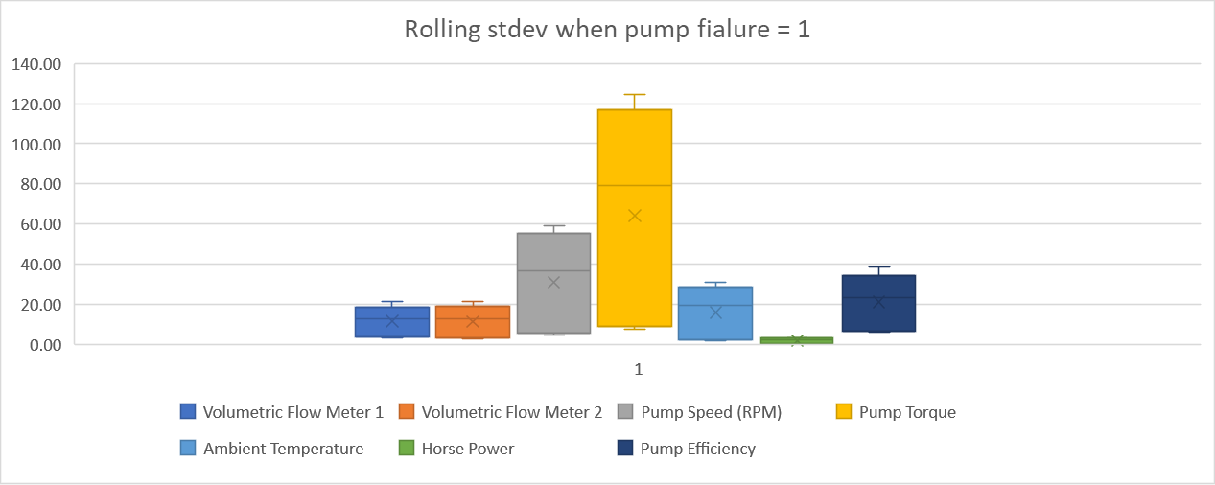
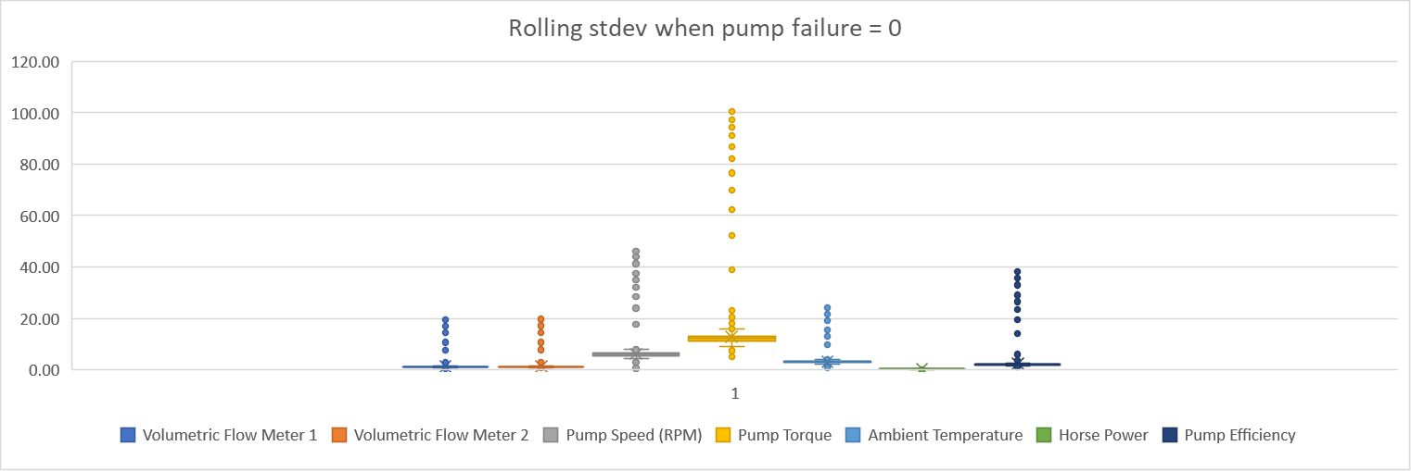
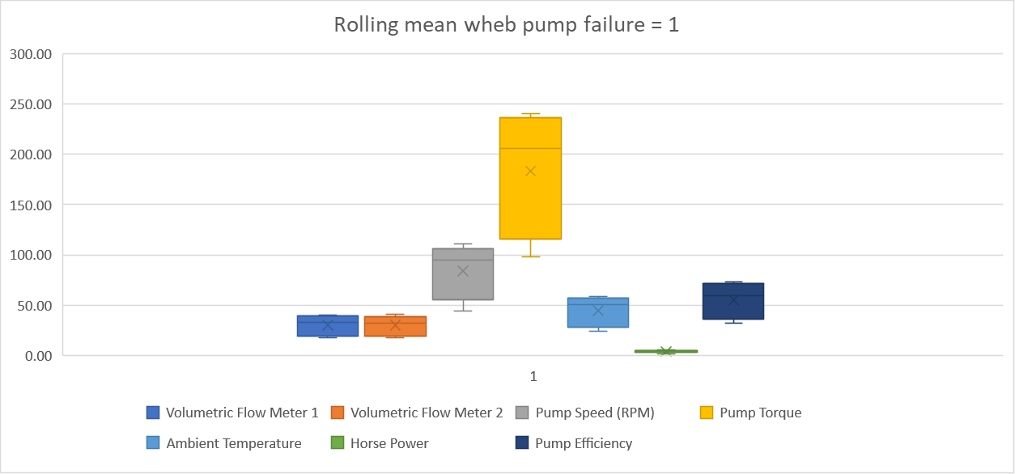
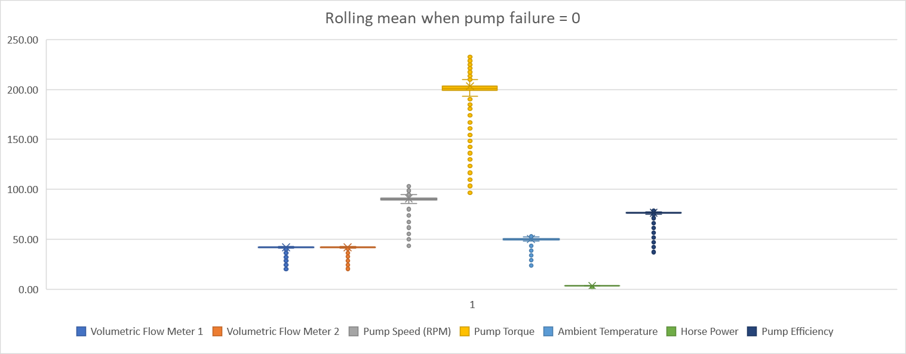
Further segmentation of the data via binary means (Pump Failure = 0 or 1) illustrated through box plots, show a clear signature difference between that of normal behaviour and that of Failure with Raw data, Rolling mean and Rolling Stdev showing the 3 largest variances.

Slide 4
Correlation analyses across datasets yield interesting insights with Horsepower, Pump speed, Pump torque, ambient temperature, volumetric flow (1&2) and Pump efficiency negatively correlated with Pump Failure in the Rolling Mean Data, whilst These exact variables show a subsequently strong positive correlation in the Rolling Stdev Dataset.

Slide 5
Lastly, analysis of the model fit reveals that with a R Squared of 40% a linear model is a bad fit for the data with variables Horsepower, Pump efficiency and Volumetric flow meter 2 having the largest coefficients, indicative that these variables have the most immediate relationship with respect to Pump Failure behaviour.

